Slide 1
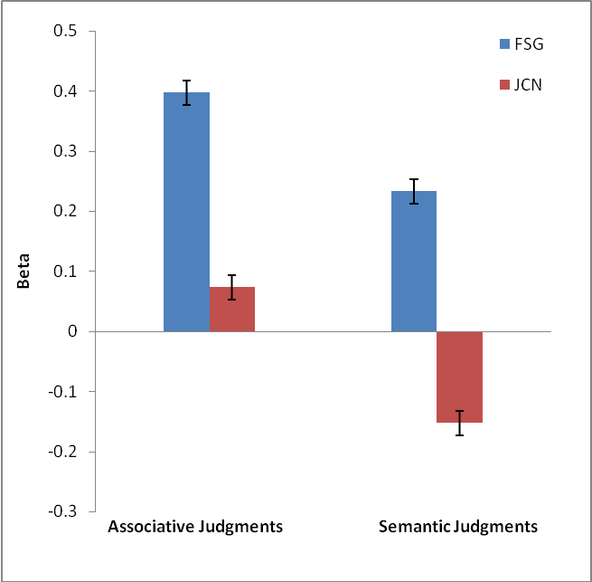
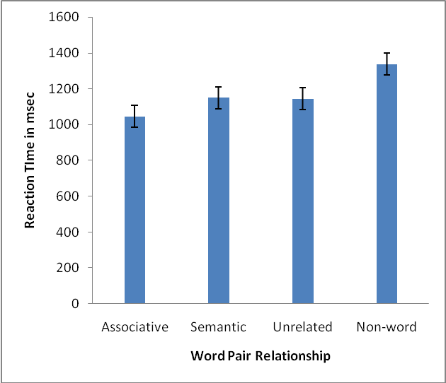
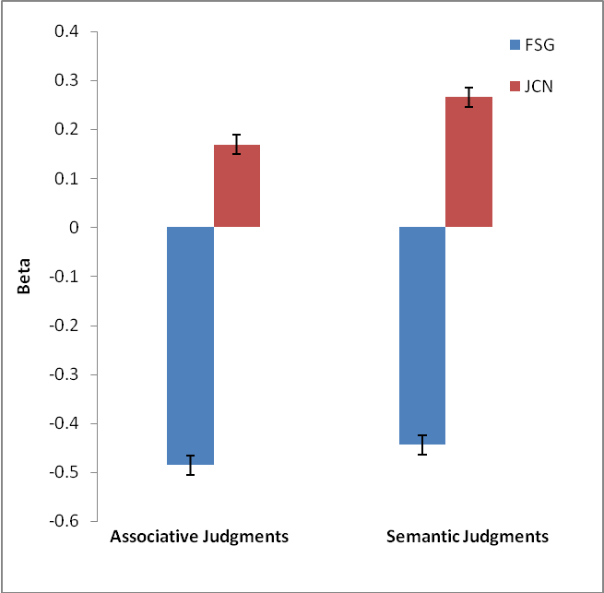


Access Into Memory: Does Associative Memory Come First?
Erin Buchanan, Ph.D., University of Mississippi
Abstract
Two experiments measuring the reaction times of semantic and associative information processing are presented here. Experiment 1 tested the speed of judgments of associative and semantic word pairs (Maki, 2007a; 2007b), and participants were able to judge associative relationships faster than semantic relationships. Interestingly, word relationship scores from database norms also predicted the reaction time for both semantic and associative judgments. Experiment 2 tested associative and semantic priming in a traditional lexical decision task, which also showed that associative word relationships were judged faster than semantic relationships.
Experiment 1 Results
Methods
Experiment 2
Materials: Word pairs created with the same databases as Experiment 1.
Priming pairs: 30 associative relationship only (PEANUT BUTTER) and 30 semantic relationship only word pairs (DEVELOP-CREATE).
Unrelated pairs: 60 word pairs (VEST-VEGTABLE).
Non-word pairs: 60 word pairs.
Procedure:
Traditional word/non-word lexical decision judgment task. Priming cue words appeared in white for 200msec, followed by a 200msec offset, and finally a target word. The target word appeared on screen until a word/nonword judgment was entered.
Associative (FSG) and Semantic (JCN) database scores as they predicted associative and semantic judgments. FSG predicts both associative and semantic judgments, while JCN predicts only semantic judgments.
Hypotheses
Experiment 1
If associative and semantic information are processed differently, then associative and semantic judgments will have significantly different reaction times.
Since associative and semantic database scores predict both types of judgments, then these database scores should predict reaction times for associative and semantic judgments.
Experiment 2
If a more traditional priming task, such as a lexical decision task, is used, then there should still be differences in reaction times to associatively and semantic related word pairs.
Associatively related word pair reaction times were significantly faster than all other judgment reaction times. Semantically related word pairs were not significantly primed over unrelated word pairs.
First, reaction times were trimmed by cutting reaction times longer than 3 standard deviations away from the mean. Associative judgment reaction times were significantly faster than semantic judgment reaction times.
Methods
Experiment 1
Materials: 232 word pairs were created from the Nelson, McEvoy, & Schreiber free association norms (2004; forward strength FSG) and the Maki, McKinley, and Thompson semantic dictionary norms (2004; WordNET JCN).
30 word pairs were used as practice items.
101 word pairs were used for experimental items, split into two blocks.
Procedure:
Associative Judgments: “How many people out of a 100 would name the second word, if given the first word?”
Given: ASHTRAY-SMOKE, participants should rate around 20 people per hundred.
Semantic Judgments: “How many features do these words share?”
Given: TORTOISES-TURTLE, participants should rate around 90 percent overlap.
Discussion
Both experiments showed faster judgment reaction times for associatively related items. Experiment 1 portrayed that higher order judgments about word relationships have differences in reaction times, while Experiment 2 illustrated that simple lexical decision judgments have the same differences in reaction times.
Experiment 1 showed a replication of previous work with judgments of semantic and associative memory and extended those findings to show that reaction times are influenced by the semantic and associative relatedness a word pair contains.
Further research is needed to examine if associative and semantic relationships are activated at different time courses when processing information. The current research suggests that associative memory may be activated first, which allows for faster judgment reaction times across various tasks.
 | Mean | SD | Range
Experiment 1
FSG | 0.215 | 0.243 | 0.010-0.780
JCN | 10.660 | 7.956 | 0.000-24.950
Finally, both associative and semantic database scores were used to predict reaction times. Unlike judgments, both associative and semantic judgments predicted reaction times for judgments.
References
Maki, W. (2007a). Judgments of associative memory. Cognitive Psychology, 54, 319-353.
Maki, W. (2007b). Separating bias and sensitivity in judgments of associative memory. Journal of Experimental Psychology: Learning, Memory, and Cognition, 33(1), 231-237.
Maki, W., McKinley, L., & Thompson, A. (2004). Semantic distance norms computed from an electronic dictionary (WordNet). Behavior Research Methods: Instruments & Computers, 36(3), 421-431.
Nelson, D., McEvoy, C., & Schreiber, T. (2004). The University of South Florida free association, rhyme, and word fragment norms. Behavior Research Methods: Instruments & Computers, 36(3), 402-407.

